Slide 1

CP3405 TR2 2026
Group 2
Sprint 6 - W28
The Bao Le
Zheng Zaikun
Hao Wang
Wenhan Hu
Guanyu Lu
Hamzah Nutt
Lu Junwen
Swan Htet Zaw
Kan Yijie
Yu-Chu Lin
WuQin Yang

Slide 2
R1 Product Owner
Sprint Goal Board
Sprint goal statement
Done Means
LAST WEEK CALIBRATION
PRIMARY QUESTION
Release no.
End-to-End Automation
Actual data covers SPX, NDX, IWM, and all 11 S&P 500 sectors
Almanac, Macro, Technical, and Data agents produce structured outputs
At least two LLMs are called through APIs
Raw LLM responses are saved for comparison
The W28 prediction file is generated
Missing or invalid market data is validated
GitHub Actions workflow runs successfully
All required evidence is committed to GitHub
The correct vW28 release tag is created
N/A
W28
Sprint Goal
Build and validate an automated W28 market prediction pipeline covering major indices, all 11 sectors, two LLM APIs, GitHub Actions, and the vW28 release tag.
Notes:
For this sprint, the main focus was agent automation.
Last week’s calibration result was +13, an impressive but grounded number as our team got all 6 predictions correct. For Week 5, we planned to make the evidence pipeline more reliable and repeatable.
The primary question was whether we could automate the agents enough to support the forecast process. For W25, the output needed to cover three indexes — SPX, NDX, and IWM — plus five sectors: Technology, Energy, Financials, Utilities, and Materials.
The sprint goal was to automate the Almanac and Technical agents so they produce structured evidence, instead of relying on manual notes. We also aimed to automate the calibration log using the existing W22 scoring rule, so the process stays consistent with previous weeks.
The “Done Means” section defines the acceptance criteria. The Almanac and Technical agents must generate structured outputs, the coverage must include all required indexes and sectors, the GitHub Actions workflow must be able to run manually and on schedule, and the W25 prediction must clearly use the automated evidence.
So the main product outcome here is not just the forecast itself. It is a more repeatable workflow that makes future weekly predictions easier to produce and easier to audit.

Slide 3
R1 Product Owner
Forecast Contract
W28 forecast contract
SPX | ^GSPC proxy
Direction: Up
Range: +0.3% to +1.5%
Confidence: Medium
NDX | ^NDX proxy
Direction: Up
Range: +0.2% to +1.0%
Confidence: Medium
IWM | IWM proxy
Direction: Neutral → Down
Range: -0.8% to +0.4%
Confidence: Low
Assumptions / Risk Trigger
Evidence Lock
Almanac: bullish XLK/XLU; bearish XLE/XLB
Macro: neutral to moderately bullish
Technical: SPX and NDX bullish; IWM slightly bearish
Final prediction: Neutral-Bullish
1. Assumption: Final W28 calls combine Almanac, Macro,
Technical, and latest market evidence.
2. Risk trigger: Hawkish FOMC signals, sharply rising
Treasury yields, or a break below key technical support
may invalidate the forecast.
Notes:
The overall team view is neutral-bullish. For the three main indexes, we are forecasting SPX, NDX, and IWM to move up, but with medium confidence rather than high confidence. NDX has the strongest index range because technology and AI-related names are still showing leadership.
For sectors, Technology is the highest-conviction positive call. XLK is forecast up 1.0% to 2.5% with medium-high confidence because the macro and technical evidence both support continued technology leadership.
Energy is the weakest call. XLE is forecast down because crude oil weakness and negative seasonal factors are creating pressure on the sector.
Financials and Materials are both neutral-to-up. They have some support from resilient growth and market sentiment, but not enough to make them as strong as Technology. Utilities are neutral because they have defensive support, but they are not showing strong leadership.
The key assumption is that AI and technology leadership, together with resilient economic growth, can offset the weak W25 seasonal pattern. The main risk trigger is hotter-than-expected PCE inflation or a more hawkish Fed shift. Technically, the forecast also weakens if SPX falls below its 8-day and 21-day EMAs.
The evidence lock shows the main contradiction clearly: the Almanac is bearish for W25 seasonality, but macro and technical evidence are more constructive. That is why the final forecast is neutral-bullish, not fully bullish.

Slide 4
R1 Product Owner
Forecast Contract
Sector | Ticker | Direction | Forecast Range | Confidence
Technology | XLK | Up | +0.5% to +1.8% | Medium-High
Communication Services | XLC | Up | +0.3% to +1.5% | Medium
Consumer Discretionary | XLY | Neutral | -0.5% to +0.8% | Medium
Financials | XLF | Neutral → Up | -0.4% to +0.8% | Medium
Health Care | XLV | Down | -1.2% to +0.2% | Medium
Consumer Staples | XLP | Neutral → Down | -0.8% to +0.4% | Medium
Energy | XLE | Neutral → Up | -0.5% to +1.8% | Medium
Utilities | XLU | Neutral | -0.6% to +0.6% | Medium
Industrials | XLI | Down | -1.0% to +0.3% | Medium
Materials | XLB | Down | -1.3% to +0.2% | Medium
Real Estate | XLRE | Neutral → Down | -0.8% to +0.4% | Medium
Notes:
The overall team view is neutral-bullish. For the three main indexes, we are forecasting SPX, NDX, and IWM to move up, but with medium confidence rather than high confidence. NDX has the strongest index range because technology and AI-related names are still showing leadership.
For sectors, Technology is the highest-conviction positive call. XLK is forecast up 1.0% to 2.5% with medium-high confidence because the macro and technical evidence both support continued technology leadership.
Energy is the weakest call. XLE is forecast down because crude oil weakness and negative seasonal factors are creating pressure on the sector.
Financials and Materials are both neutral-to-up. They have some support from resilient growth and market sentiment, but not enough to make them as strong as Technology. Utilities are neutral because they have defensive support, but they are not showing strong leadership.
The key assumption is that AI and technology leadership, together with resilient economic growth, can offset the weak W25 seasonal pattern. The main risk trigger is hotter-than-expected PCE inflation or a more hawkish Fed shift. Technically, the forecast also weakens if SPX falls below its 8-day and 21-day EMAs.
The evidence lock shows the main contradiction clearly: the Almanac is bearish for W25 seasonality, but macro and technical evidence are more constructive. That is why the final forecast is neutral-bullish, not fully bullish.

Slide 5
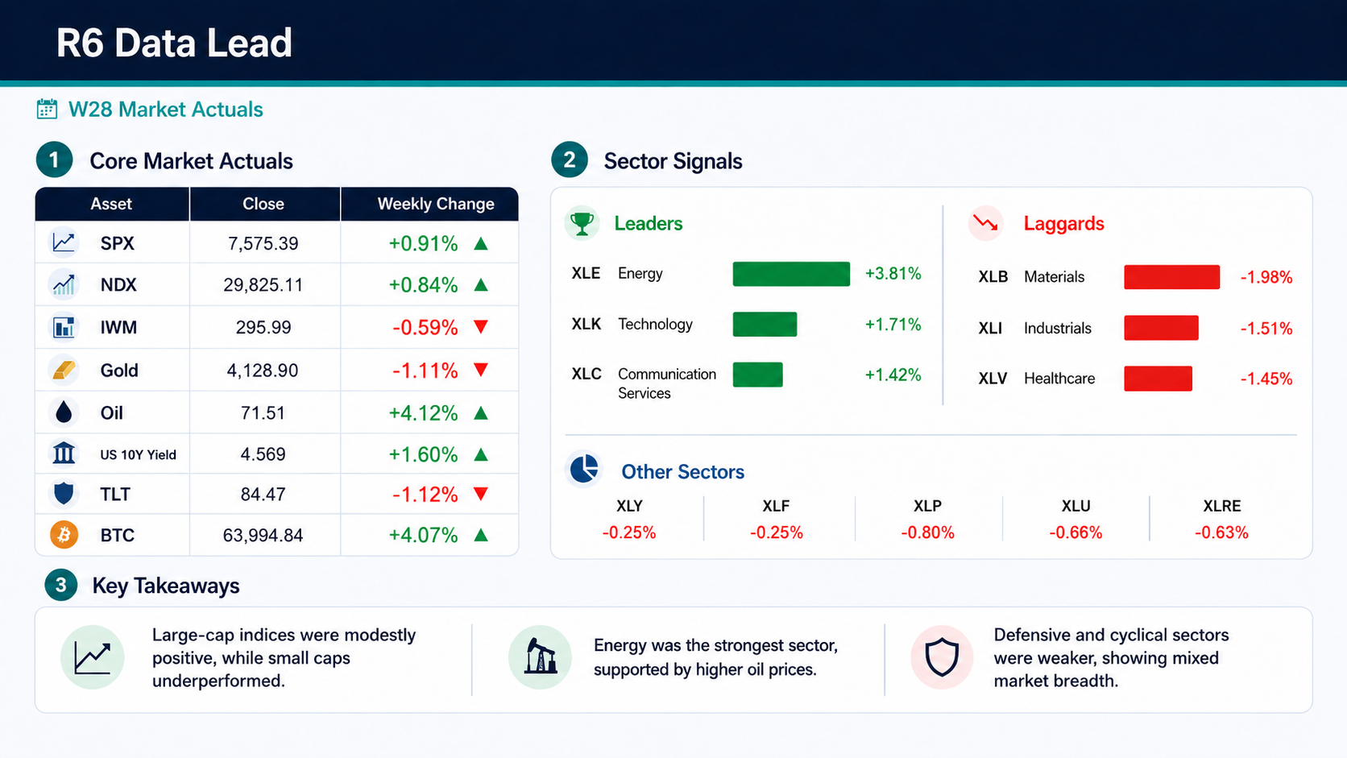
R6 Data Lead
Notes:
This week I am presenting the R6 data lead. Because of the study week and our team did not make a prediction， so the purpose of this slide is to show W28 market actuals and the sector signal.
The core market result was mixed. SPX increased by 0.91% and NDX increased by 0.84%, so large-cap indices were positive. However, IWM fell by 0.59%, which means small caps did not confirm the same strength.
For cross-asset context, Oil was very strong, up 4.12%, while Gold and TLT were both negative. This fits the sector result because Energy was the strongest sector at +3.81%. Technology and Communication Services were also positive, but only 3 of the 11 sectors were up overall.
The weakest sectors were Materials, Industrials, and Healthcare. So my interpretation is that the market move was concentrated, not broad-based. Large-cap and Energy leadership mattered more than general market breadth.

Slide 6
R3 Almanac Lead
Dynamic Thesis
Sector Strategy Matrix (25-Yr Baseline)
Strategic seasonal evaluation for W28 aligns with historical July parameters. Focus deployment vectors toward Tech proxies (XLK) while mitigating exposures in traditionally stagnant Midterm vectors.
XLK
Long
XLU
Long
Technology
Utilities
Index Performance Baseline
+10.87%
Mid March to Mid July
+9.32%
Mid March to Early Oct
Index | Rank | Normal | Midterm
S&P 500 (SPX) | 4 | +1.3% | +1.3%
NASDAQ (NDX) | 7 | +0.9% | -0.8%
Russell 2000 (IWM) | 9 | +0.4% | -2.5%
XLE
Short
XLB
Short
Energy
Materials
-5.67%
Early June to Late Aug
-5.10%
Mid May to Mid Oct
Notes:
Hello everyone. I am presenting our forward-looking historical pattern intelligence for W28.
Our thesis is clear: while the S&P 500 historically remains strong in July, the U.S. Midterm Election Year cycle introduces a heavy divergence, dragging NASDAQ down to -0.8% and Russell 2000 down to a steep -2.5%.
Therefore, our immediate action plan is tactical portfolio tilting: Maximize weight into Tech (XLK) to capture its +10.87% historical alpha, while completely cutting exposure to Financials (XLF), Energy (XLE), and Materials (XLB).
This dataset has been fully automated via our cloud infrastructure to ensure precise alignment before market open. Thank you, and I am open to any questions.

Slide 7
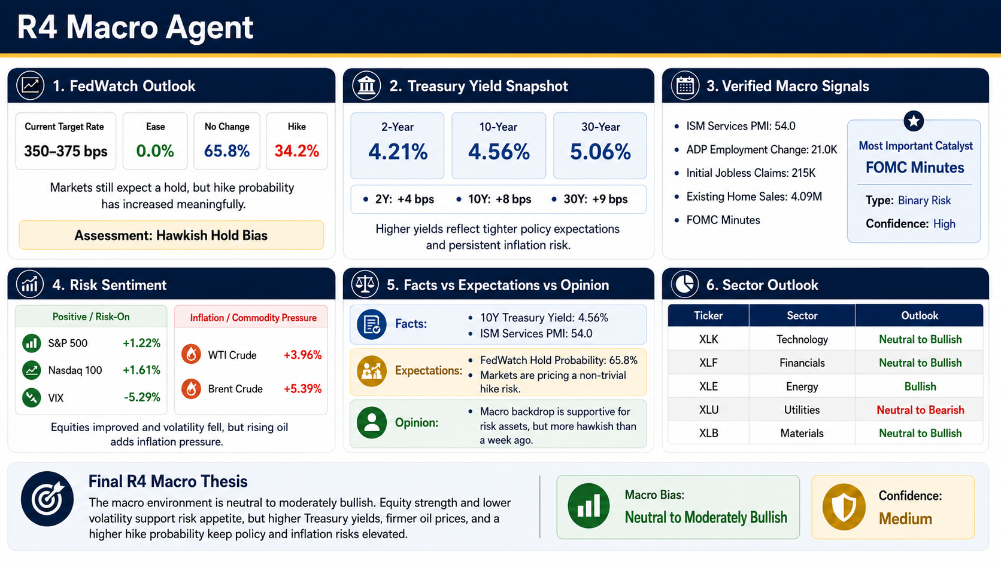
Notes:
This week, I focused on collecting and analysing macroeconomic data to understand the current market outlook.
From the data I collected, the market is still expecting the Federal Reserve to keep interest rates unchanged. However, compared with last week, expectations have become slightly more hawkish, which means investors are becoming more cautious about future monetary policy.
I also found that Treasury yields and oil prices both increased during the week. This suggests that inflation pressure is still an important risk that could affect the market in the coming weeks.
On the other hand, the major U.S. stock indices performed well and market confidence improved, showing that investors are still willing to take some risk despite these concerns.
Based on all the macro indicators, my overall conclusion is that the market outlook is neutral to moderately bullish. The market still has positive momentum, but investors should continue to watch interest rates, inflation, and upcoming economic events closely.

Slide 8
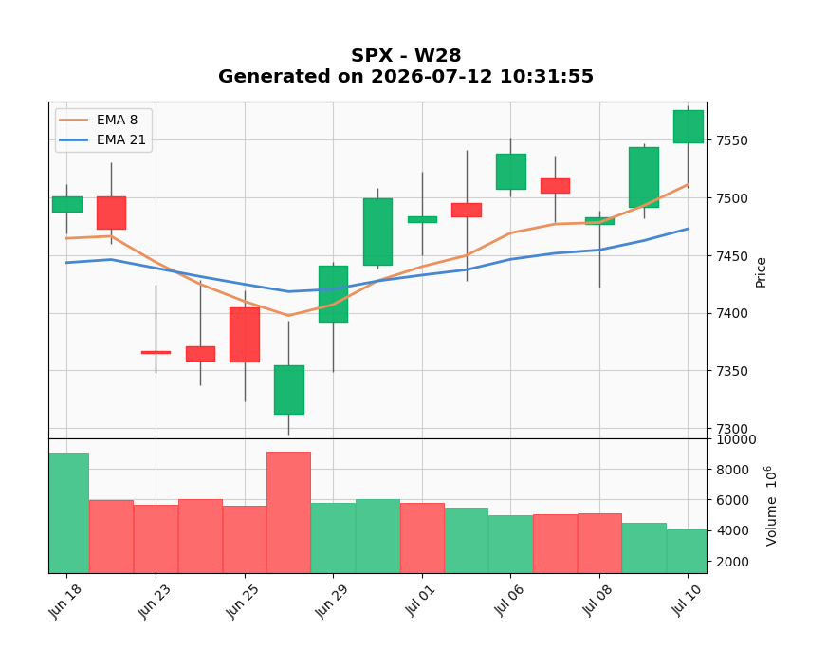
R5 Technical Lead
S&P 500 (SPX)
Current Trend: Bullish / Recovery
Close Price: 7570
8-Day EMA: 7510
21-Day EMA: 7475
Support Level: 7500–7510
Resistance Level: 7570–7580
Technical Bias: Bullish
Confidence: 75% (High)

Slide 9
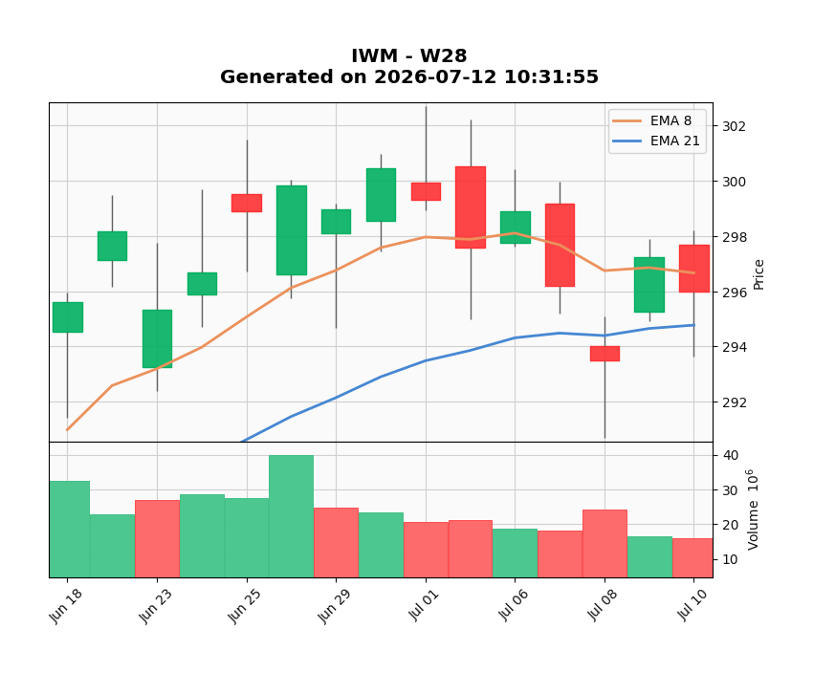
R5 Technical Lead
Russell 2000 ETF (IWM)
Current Trend: Bullish /Consolidation
• Close Price: 296.0
• 8-Day EMA: 296.5
• 21-Day EMA: 294.6
• Support Level: 294–295
• Resistance Level: 300–302
• Technical Bias: Moderately Bullish
• Confidence: 70% (Medium-High)

Slide 10
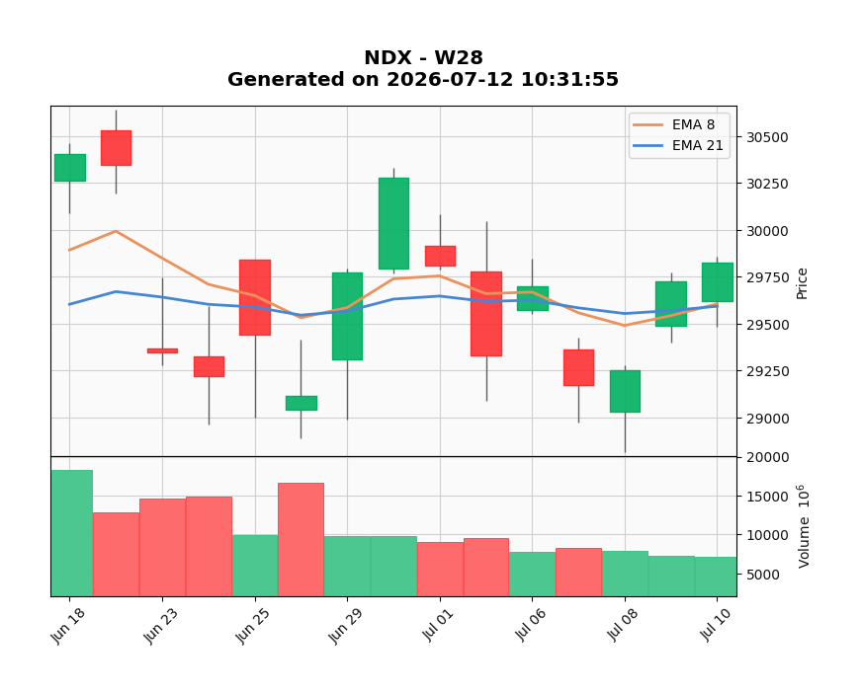
R5 Technical Lead
NASDAQ 100 (NDX)
Current Trend: Bullish / Recovery
Close Price: 29,720
8-Day EMA: 29,680
21-Day EMA: 29,610
Support Level: 29,600–29,650
Resistance Level: 29,900–30,000
Technical Bias: Moderately Bullish
Confidence: 70% (Medium-High)

Slide 11
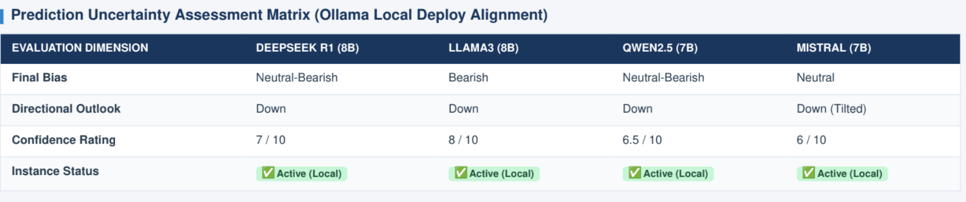
R8 LLM Operator
Notes:
1. Core Summary & Uncertainty Metrics
Consensus Bias: Neutral-Bearish (Unanimous Local Alignment)
Directional Call: Down
Prediction Uncertainty: Low (High convergence across heterogenous architectures)
Expected SPX Trading Range: 7,360 – 7,420
Primary Catalyst: U.S. CPI/PPI Inflation Data & Asymmetric Macro Risk Breakout
2. Multi-Model Matrix
DeepSeek R1 (8b): Neutral-Bearish | Confidence: 7/10 | Cites systemic breakdown below 8/21 EMAs and valuation pressure from elevated 10Y yields (4.55%).
Llama3 (8b): Bearish | Confidence: 8/10 | Highlights midterm election year June seasonality overlays (-2.1% historical average) and Memorial Day week patterns.
Qwen2.5 (7b): Neutral-Bearish | Confidence: 6.5/10 | Identifies macro-technical confluence and potential geopolitical tail risk premium from Iran.
Mistral (7b): Neutral | Confidence: 6/10 | Recommends tactical downside hedging due to muted upside volatility post-options expiration.

Slide 12
R7 Human Score
Human Score Dashboard
Macro / News
( +1 )
-Fed hold still likely
-Equities higher
-Lower VIX
-Hawkish risk remains
Technical
(+1)
-Above 8 & 21 EMA
-Bullish SPX & IWM
-NDX early recovery
-Medium confidence
Almanac
(+1)
-July seasonality
-XLK still LONG
-Neutral-Bullish
-Better than June
AI Agreement
(0)
-No AI comparison
-Human review
-Neutral score
Wild Card
(+1)
-Technology leadership
-Market resilience
-AI investment
-Strong momentum
TOTAL SCORE: +4 (NEUTRAL-BULLISH)
Bullish technical momentum and favorable July seasonality support equities, while rising Treasury yields and hawkish Fed expectations remain the main risks.
Notes:
This week, our Human Score increased from +2 to +4, showing that market conditions have become more supportive than last week. The main positives were continued economic resilience, bullish technical momentum, and a more favorable July seasonal backdrop. The S&P 500 and Russell 2000 remain above their 8-day and 21-day EMAs, while the Nasdaq 100 continues to recover. Technology also remains the market leader and continues to benefit from strong investor interest. However, rising Treasury yields, higher oil prices, and more hawkish Federal Reserve expectations still present important risks. Taking everything together, we maintained a Neutral-Bullish outlook with stronger conviction than Week 25.

Slide 13
R7 Human Score
HUMAN OVERRIDE
AI CONSENSUS
• Bullish technical trend
• Economic resilience
• July seasonality
• Technology leadership
• Neutral-Bullish
HUMAN ADJUSTMENT
• High Treasury yields
• Hawkish Fed risk
• Rising oil prices
• Inflation pressure
FINAL VIEW: Bullish momentum and stronger July seasonality support the market, but higher yields and hawkish Fed expectations keep the outlook Neutral-Bullish.
Notes:
Overall, our assessment remains Neutral-Bullish based on the combined Macro, Technical, and Almanac Agents. The strongest positives this week are resilient economic conditions, bullish technical momentum, and supportive July seasonality, especially for the Technology sector. However, we remain cautious because Treasury yields have increased, oil prices have risen, and markets are pricing a higher probability of future Federal Reserve tightening. We also consider the upcoming FOMC Minutes to be the key event that could shift market sentiment. While Technology leadership continues to support the market, these macro risks may still create short-term volatility. For that reason, we remain constructive, but not aggressively bullish.

Slide 14
R10 QA Lead
No prediction from the previous week
Tasks for future weeks:
Refine the calibration criteria
Verify the evaluation thresholds for different market conditions
Ensure that scoring remains fair and accurate across all prediction results
Monitor the system to ensure the automated process produces reliable outcomes

